Slide 1

ChatBot Snatchbot
Teoh Teik Toe
ITOM/NBS
ttteoh@ntu.edu.sg
97905202

Slide 2
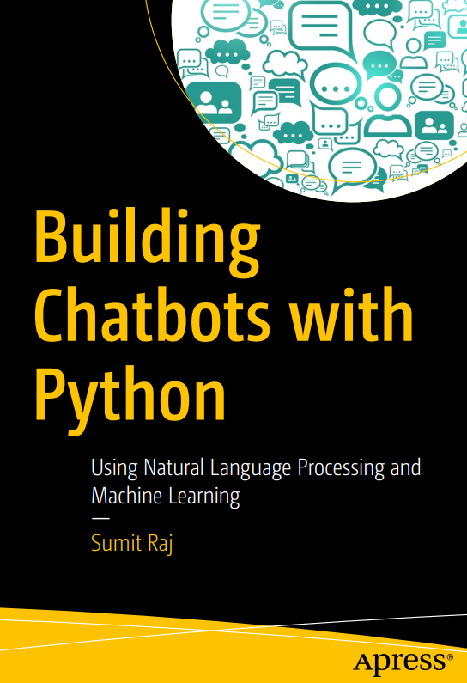
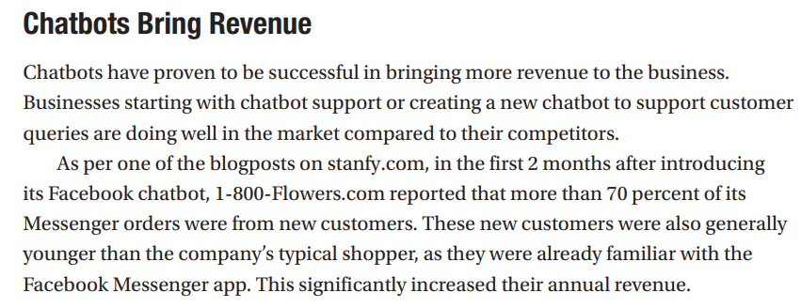
Textbook (Sumit Raj)
Page 6

Slide 3
Agenda
Create a simple Course FAQ chatbot using Snatchbot
Launch the chatbot in Telegram
Understand the ecosystem of Chatbot with Snatchbot
Chatbot in Python

Slide 4

Chatbot
A chatbot is a software application used to conduct an on-line chat conversation via text or text-to-speech, in lieu of providing direct contact with a live human agent.

Slide 5

Snatchbot
SnatchBot was founded in 2015 by Henri Ben Ezra and Avi Ben Ezra as part of the flood of technological innovations and startups that come from Israel , more precisely Herzlia Pituach .
In July 2017, Snatchbot was one of the sponsors of the Chatbot summit in Berlin . By December 2017, more than 30 million users had contacted chatbots that were created on the SnatchBot platform.

Slide 6
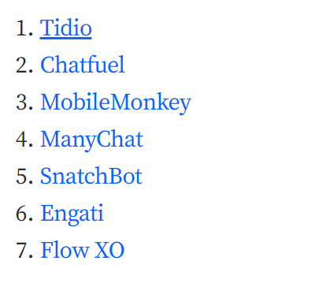
7 Best Chatbot Platforms for Companies
https://www.tidio.com/blog/best-chatbot-platforms/

Slide 7
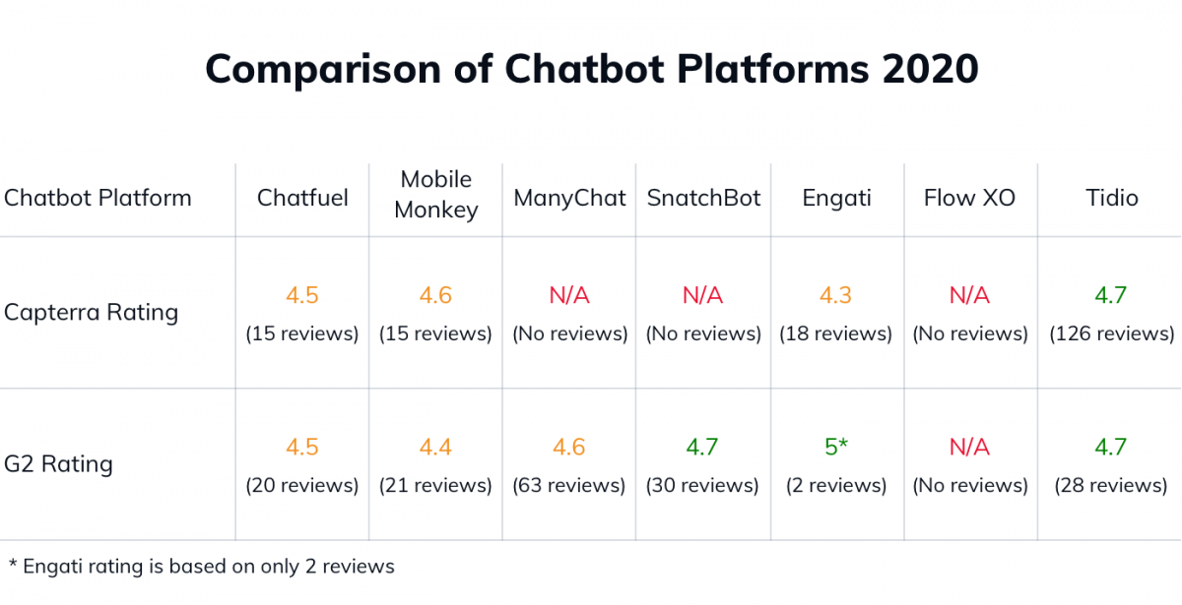
G2 Rating

Slide 8
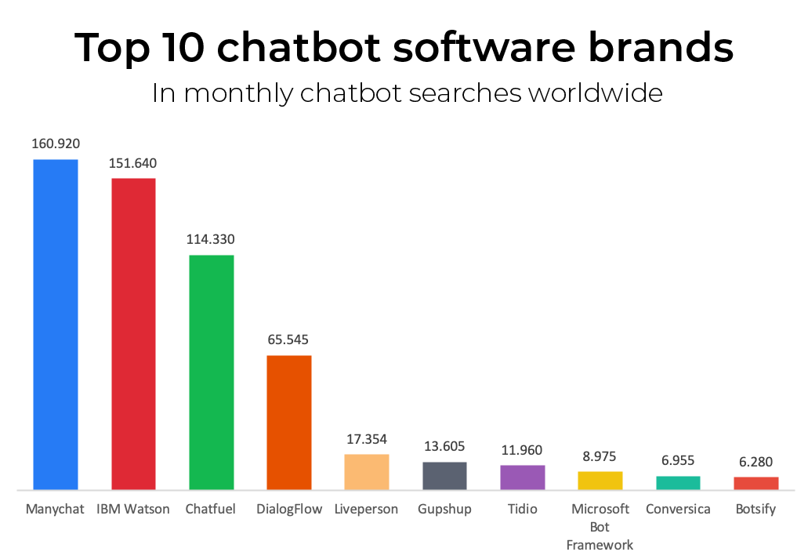
types of chatbot
https://images.app.goo.gl/qkzwk27jzj7Nx8B59

Slide 9
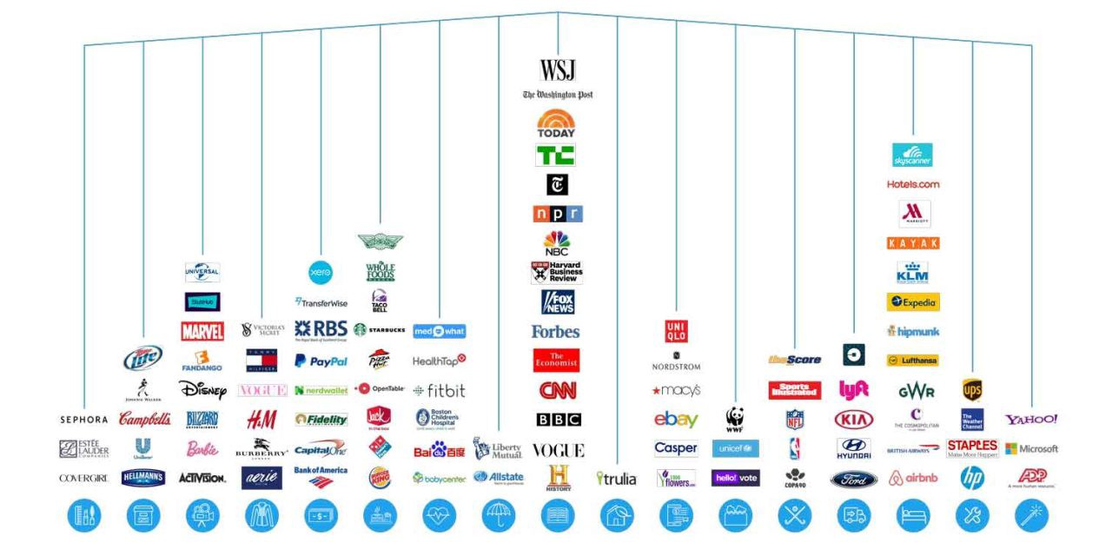
types of chatbot
https://images.app.goo.gl/67VWj3z6t6jPejjv9

Slide 10
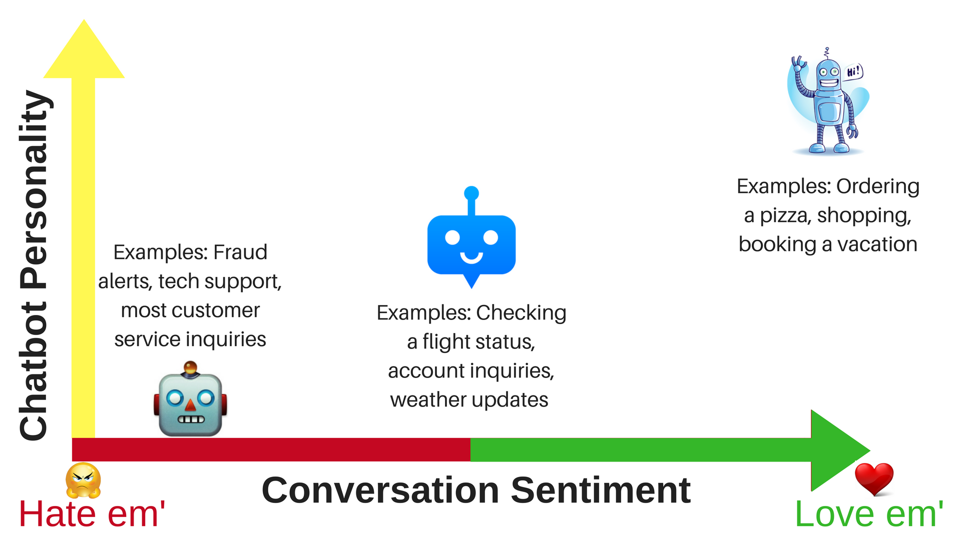

types of chatbot
https://images.app.goo.gl/NzENg44GjRycR1kT8

Slide 11
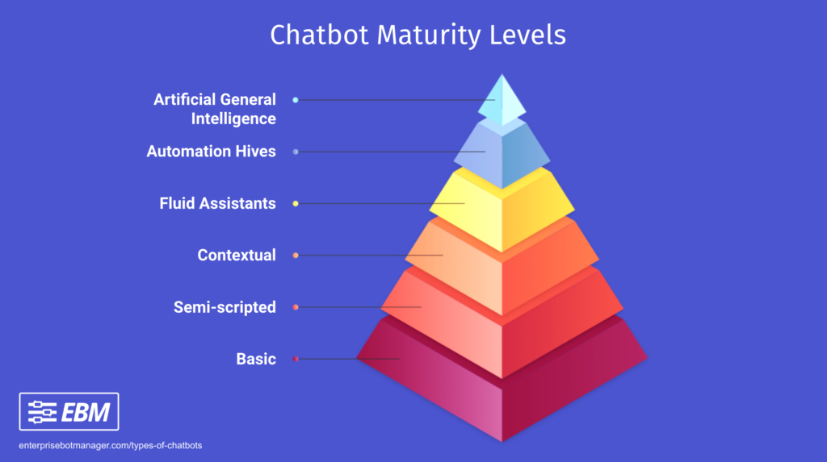
types of chatbot
https://images.app.goo.gl/MJSsjL1mHdUY2FRs5

Slide 12
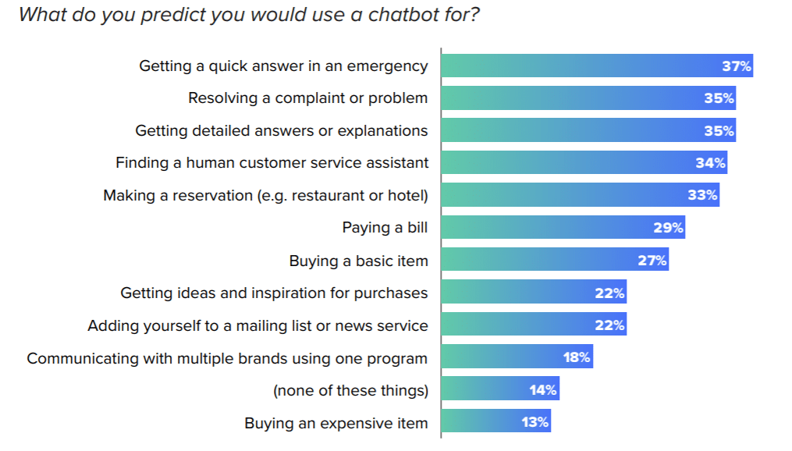
Application of CHATBOt
https://images.app.goo.gl/c1F6z7Ubht2wXZFi8

Slide 13
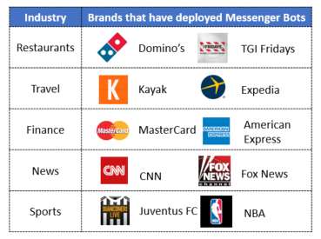
Application of CHATBOt
https://images.app.goo.gl/fYwAeXBWRFqTujkG7

Slide 14
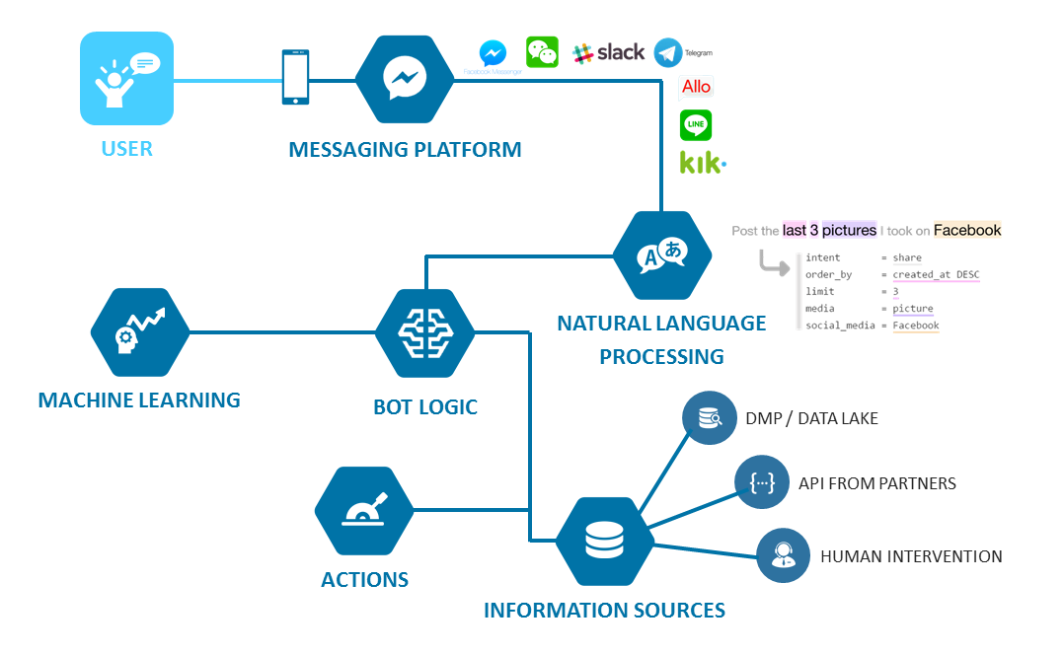
Technology in ChatBOT
https://images.app.goo.gl/FnjT8MrtVQuf6Zoa9

Slide 15
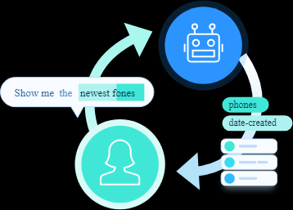
Natural Language Processing
https://images.app.goo.gl/9C6Zxh2K7TdgihzT9

Slide 16
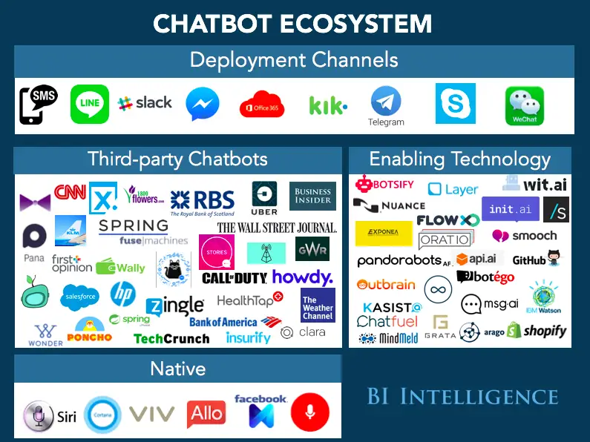
ChatBOT ECOSYSTEM
https://images.app.goo.gl/eM2g3SE9ZXuVyY9k7

Slide 17
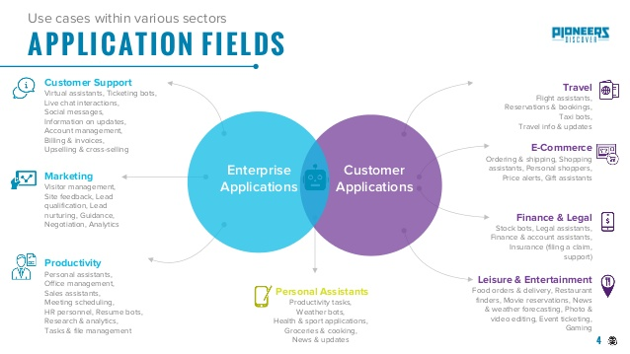
Application of CHATBOt
https://images.app.goo.gl/MBqPXiPvPNWtGB3c6

Slide 18
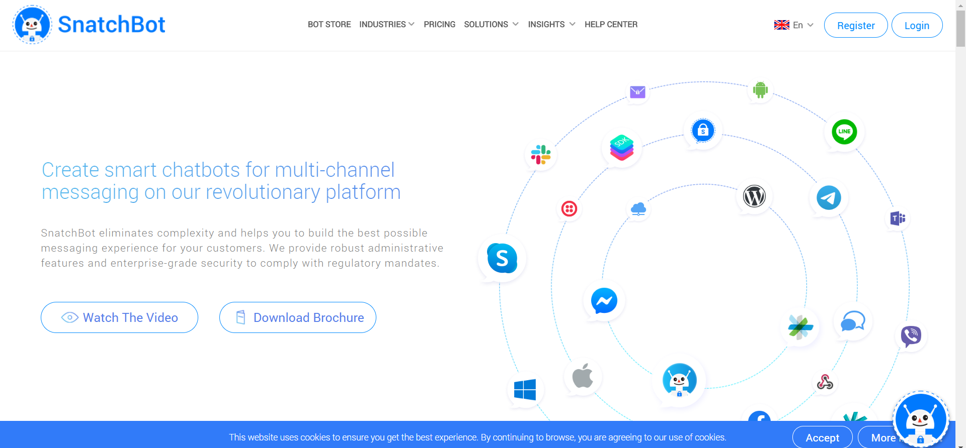
Snatchbot registration
Use browser navigate to https://snatchbot.me/
Click Register to Sign Up.
Open your mailbox to activate the account and Log in to snatchbot.me

Slide 19
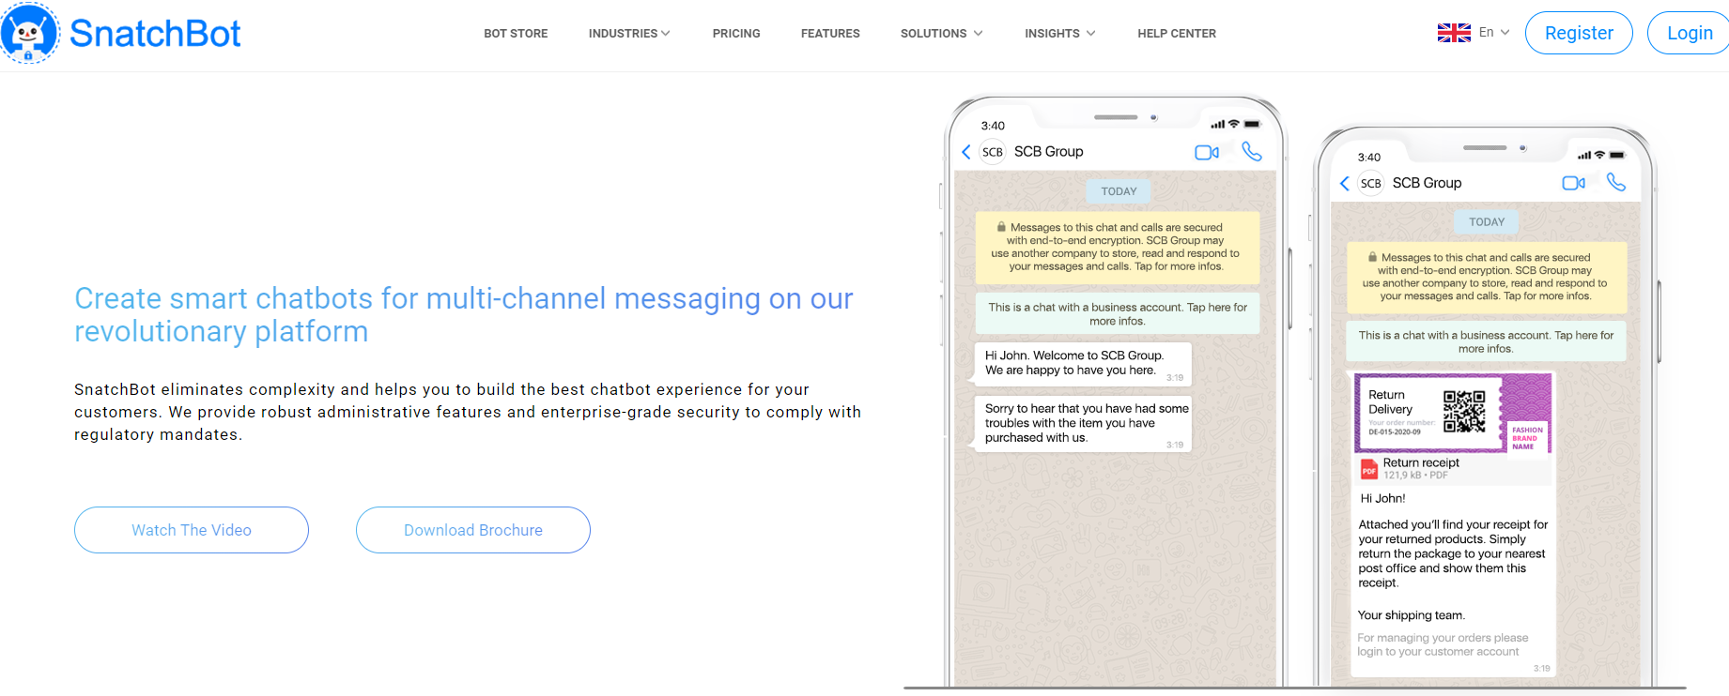
Snatchbot (Before Login)

Slide 20
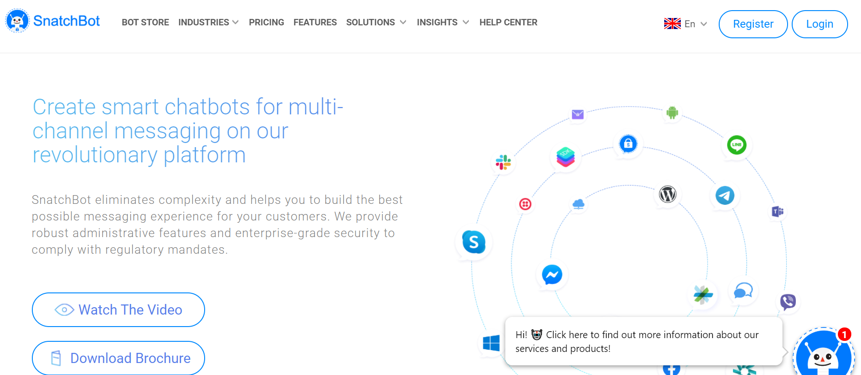
Watch the Video

Slide 21
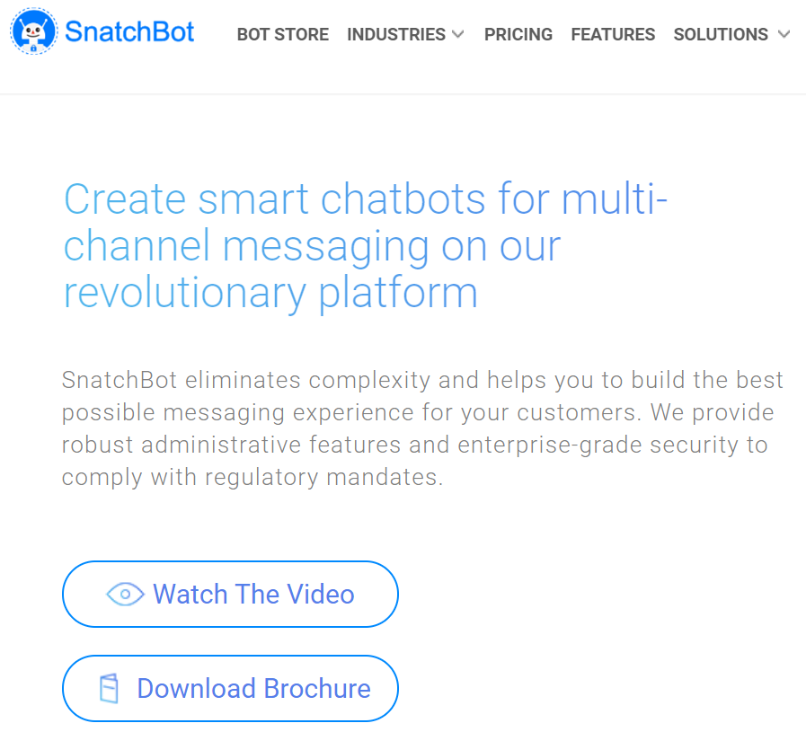
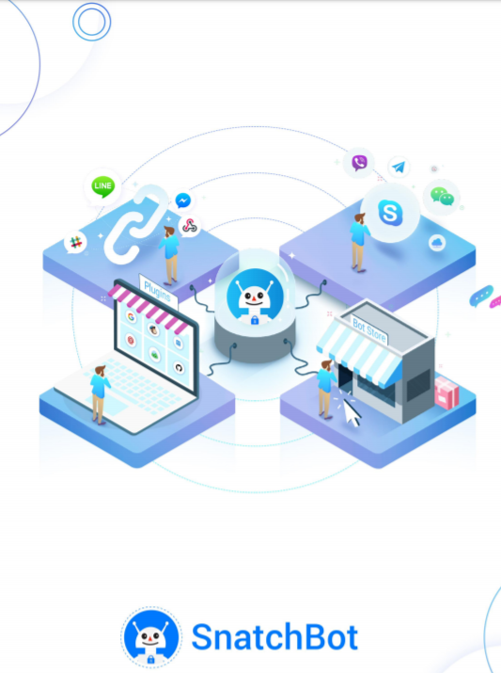
Brochure

Slide 22
Snatchbot (Before Login)

Slide 23
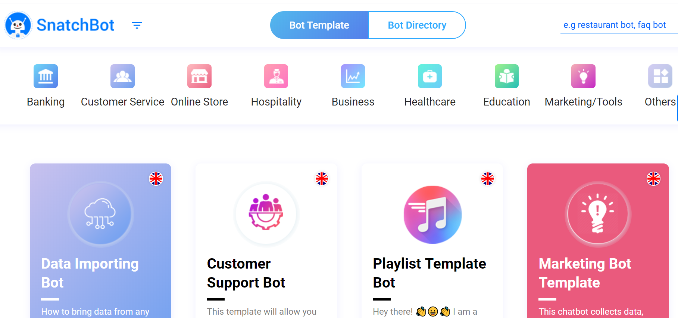
BotStore

Slide 24
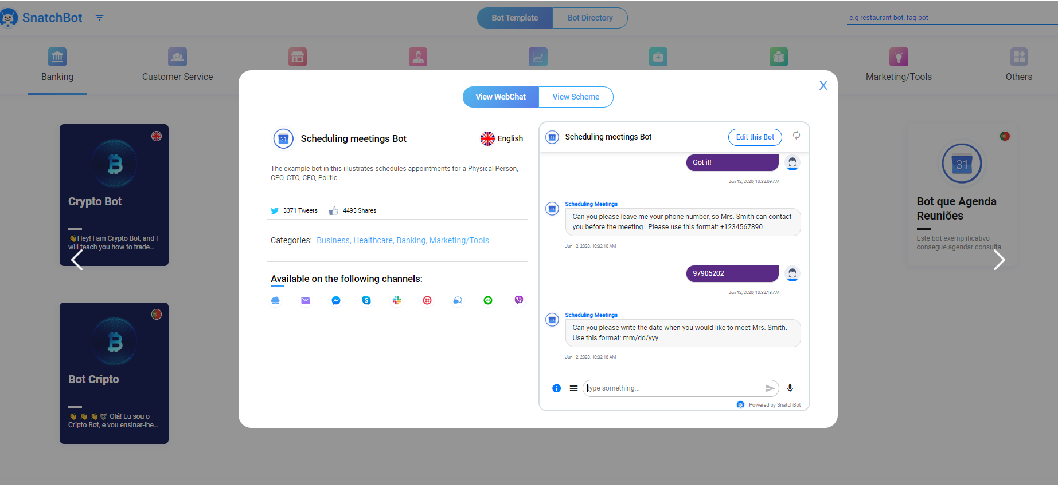
Try the Scheduling Meeting Bot (10mins)

Slide 25
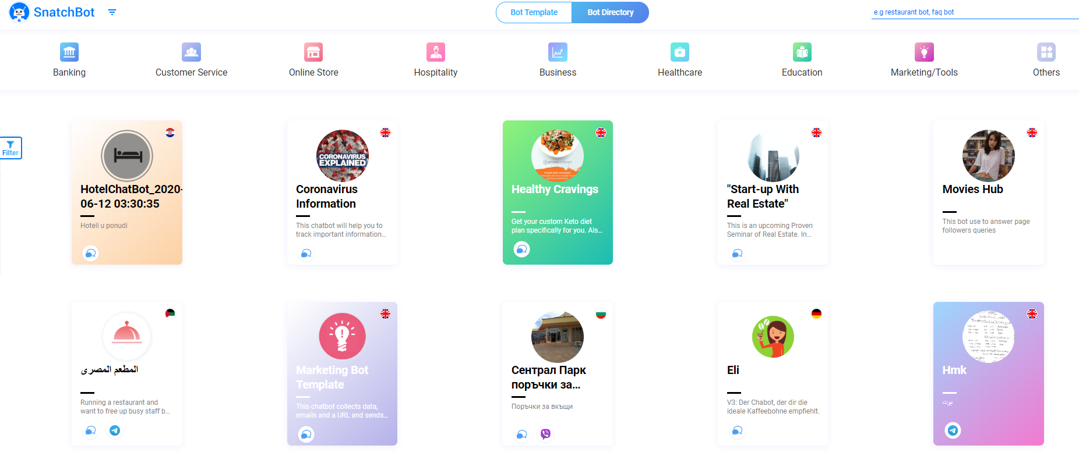
Bot Dictionary

Slide 26
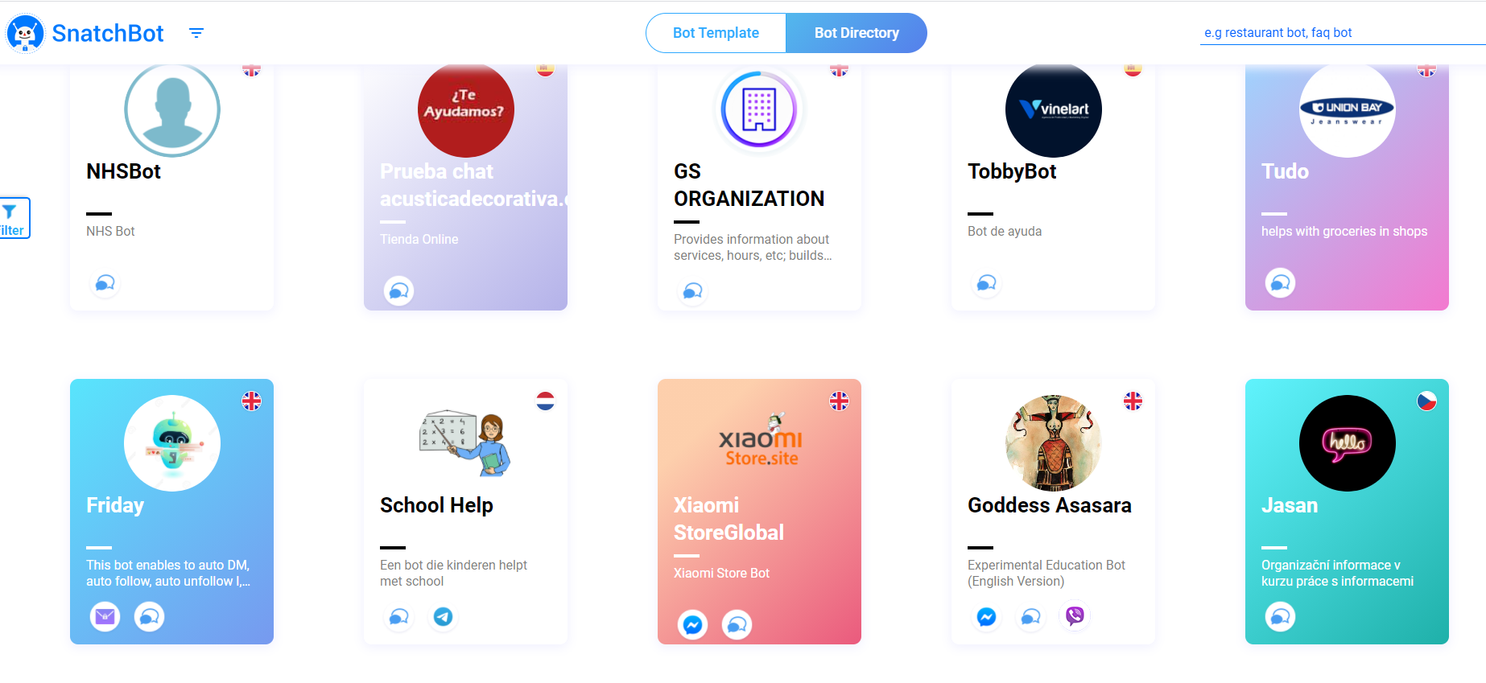
Bot Dictionary – Bot, Tweeter, Facebook

Slide 27
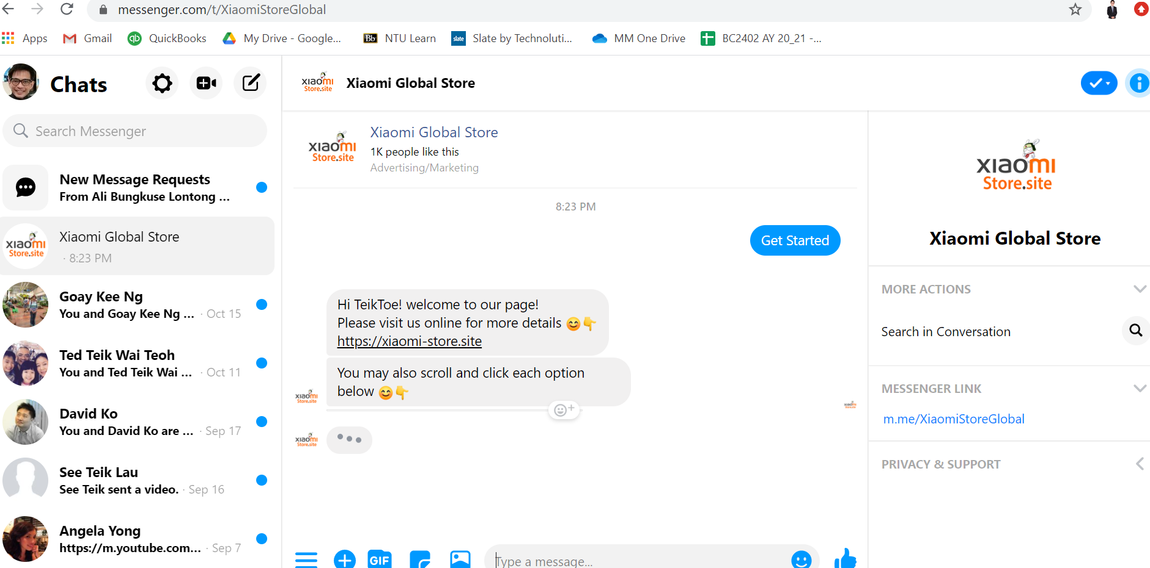
Try Chat Bot (Messenger)

Slide 28
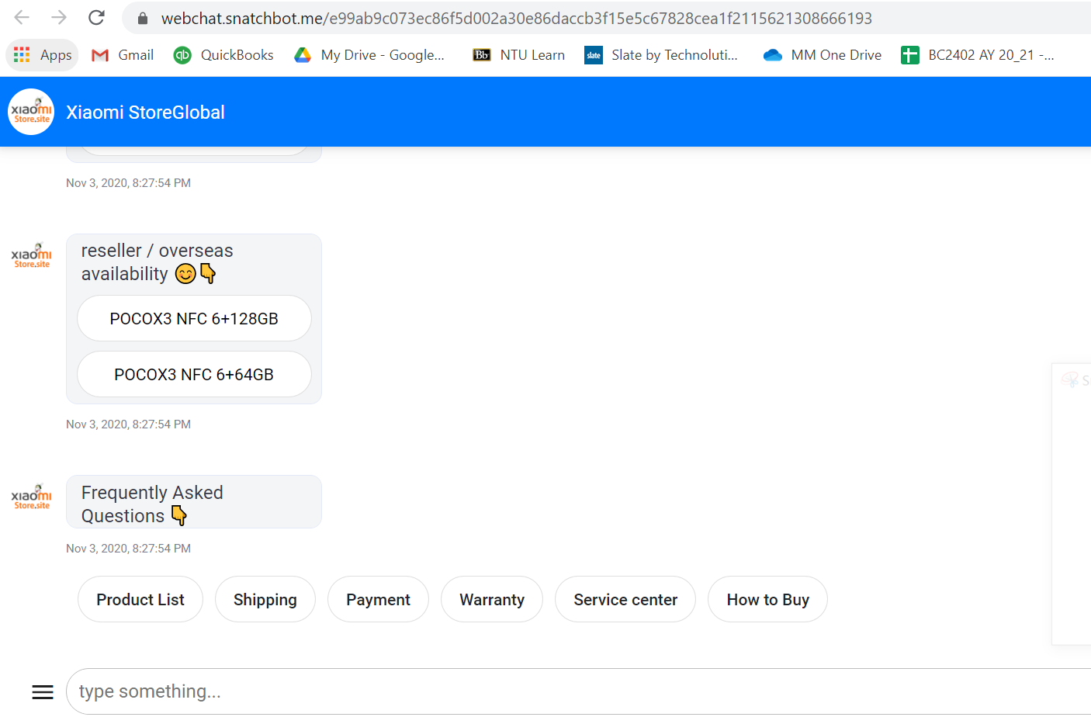
Try Chat Bot (Wechat)

Slide 29
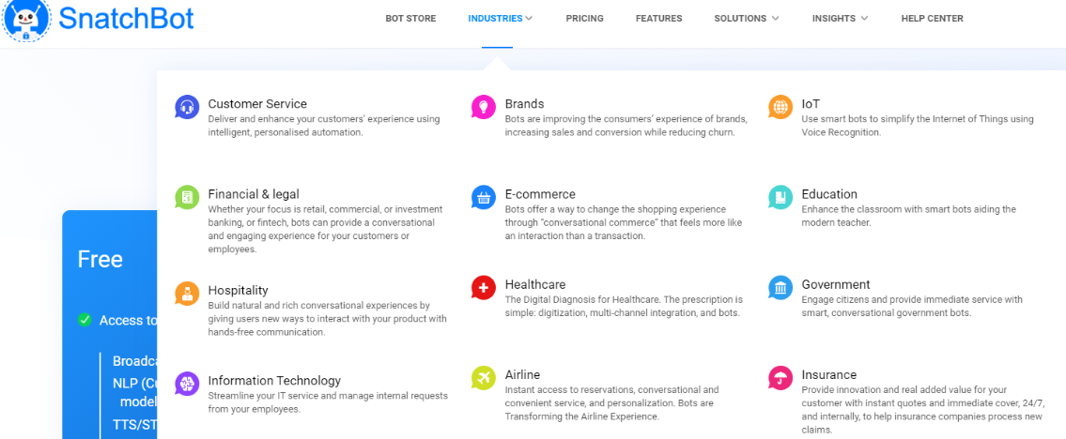
Industries

Slide 30
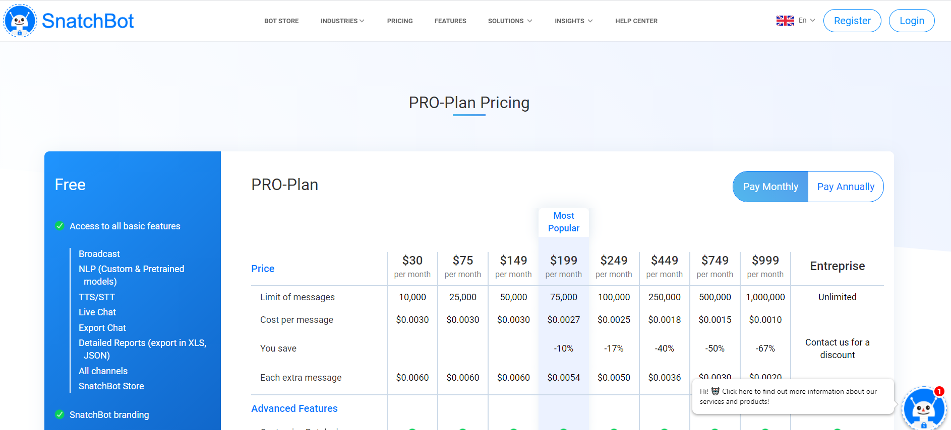
Pricing

Slide 31
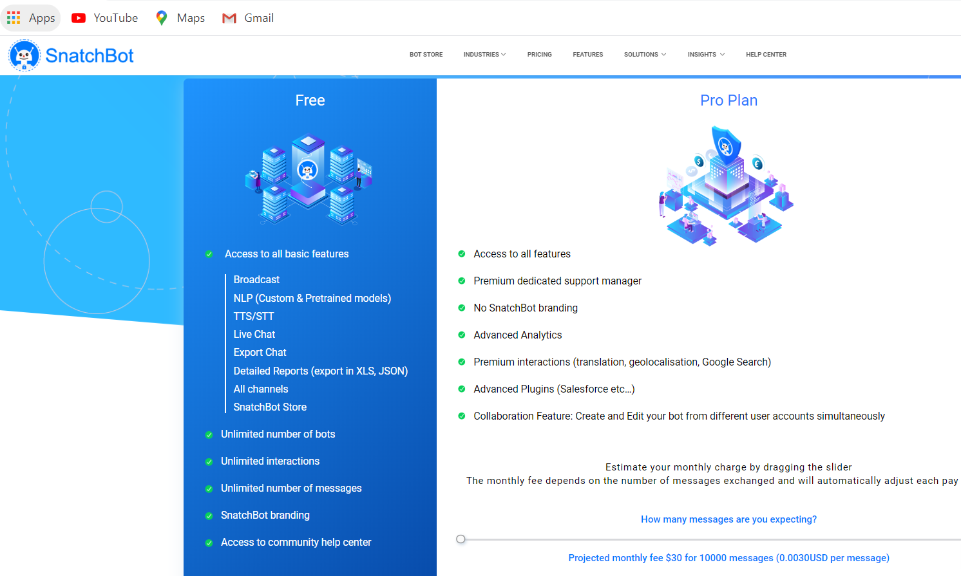
Free

Slide 32
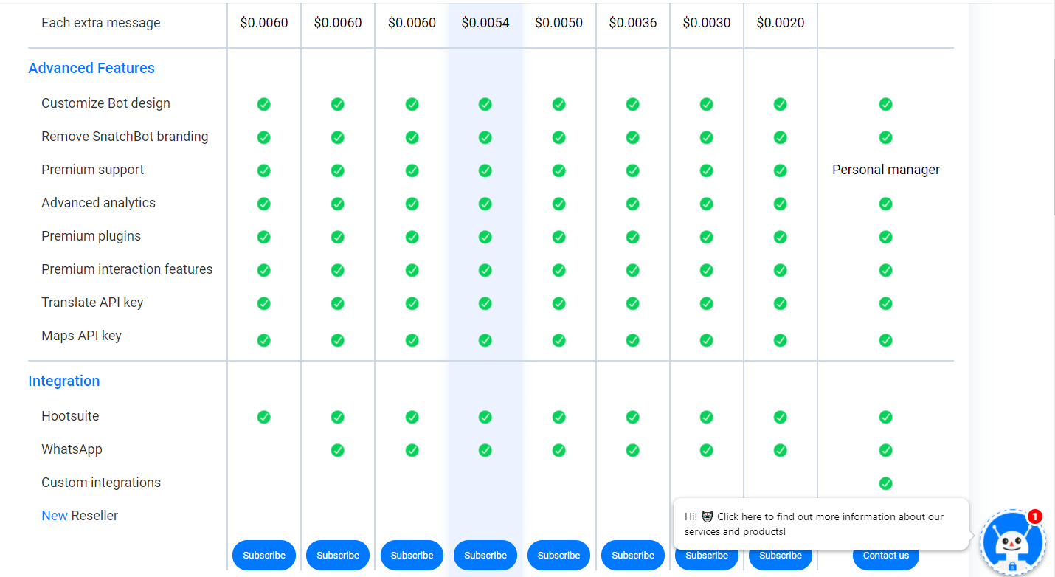
Pricing

Slide 33
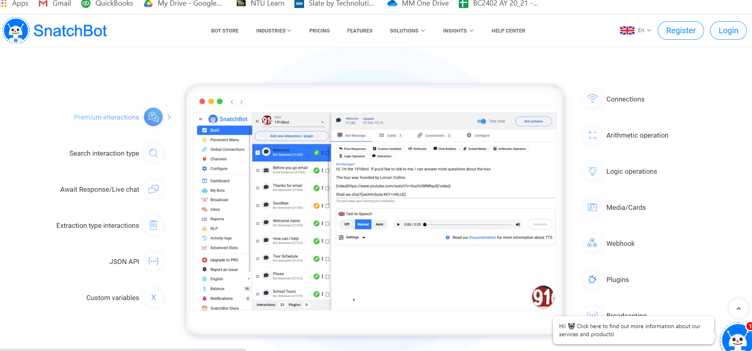
Feature

Slide 34
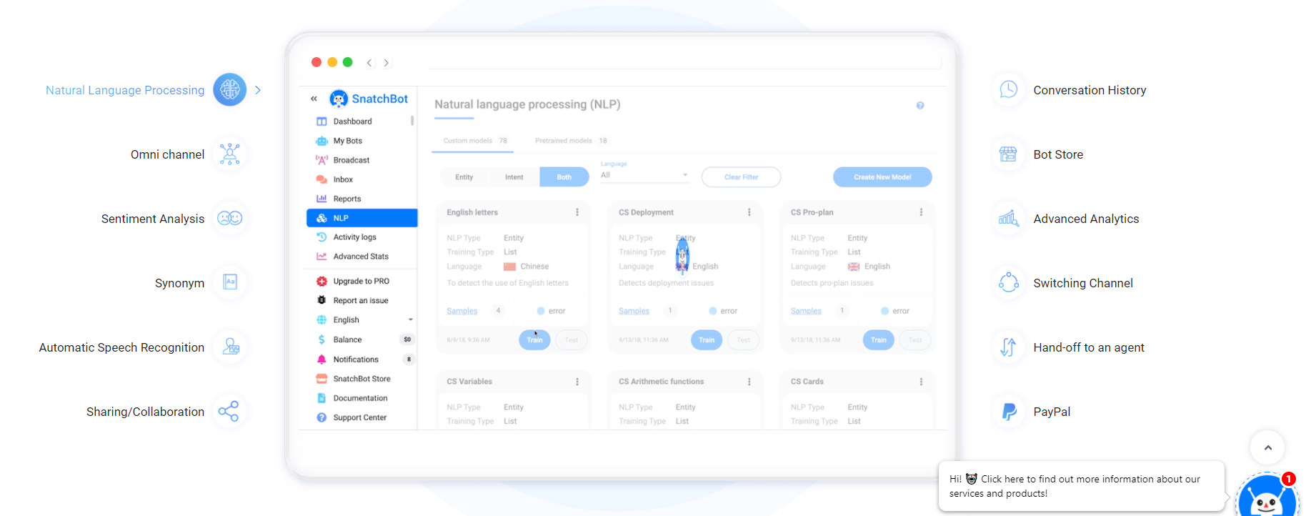
Feature

Slide 35
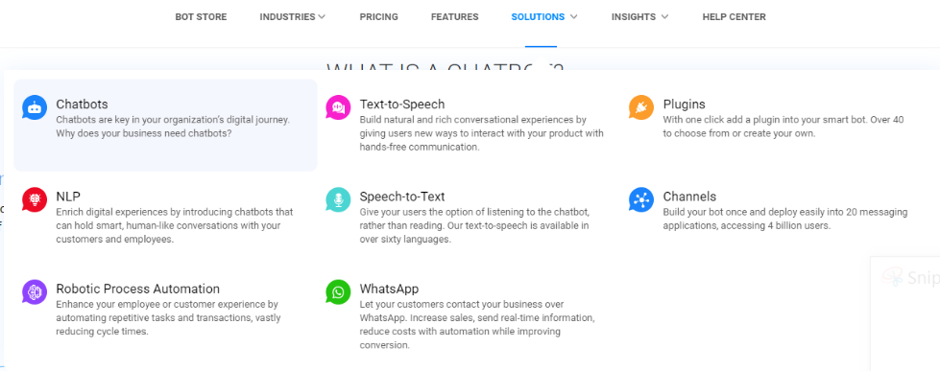
Solution

Slide 36
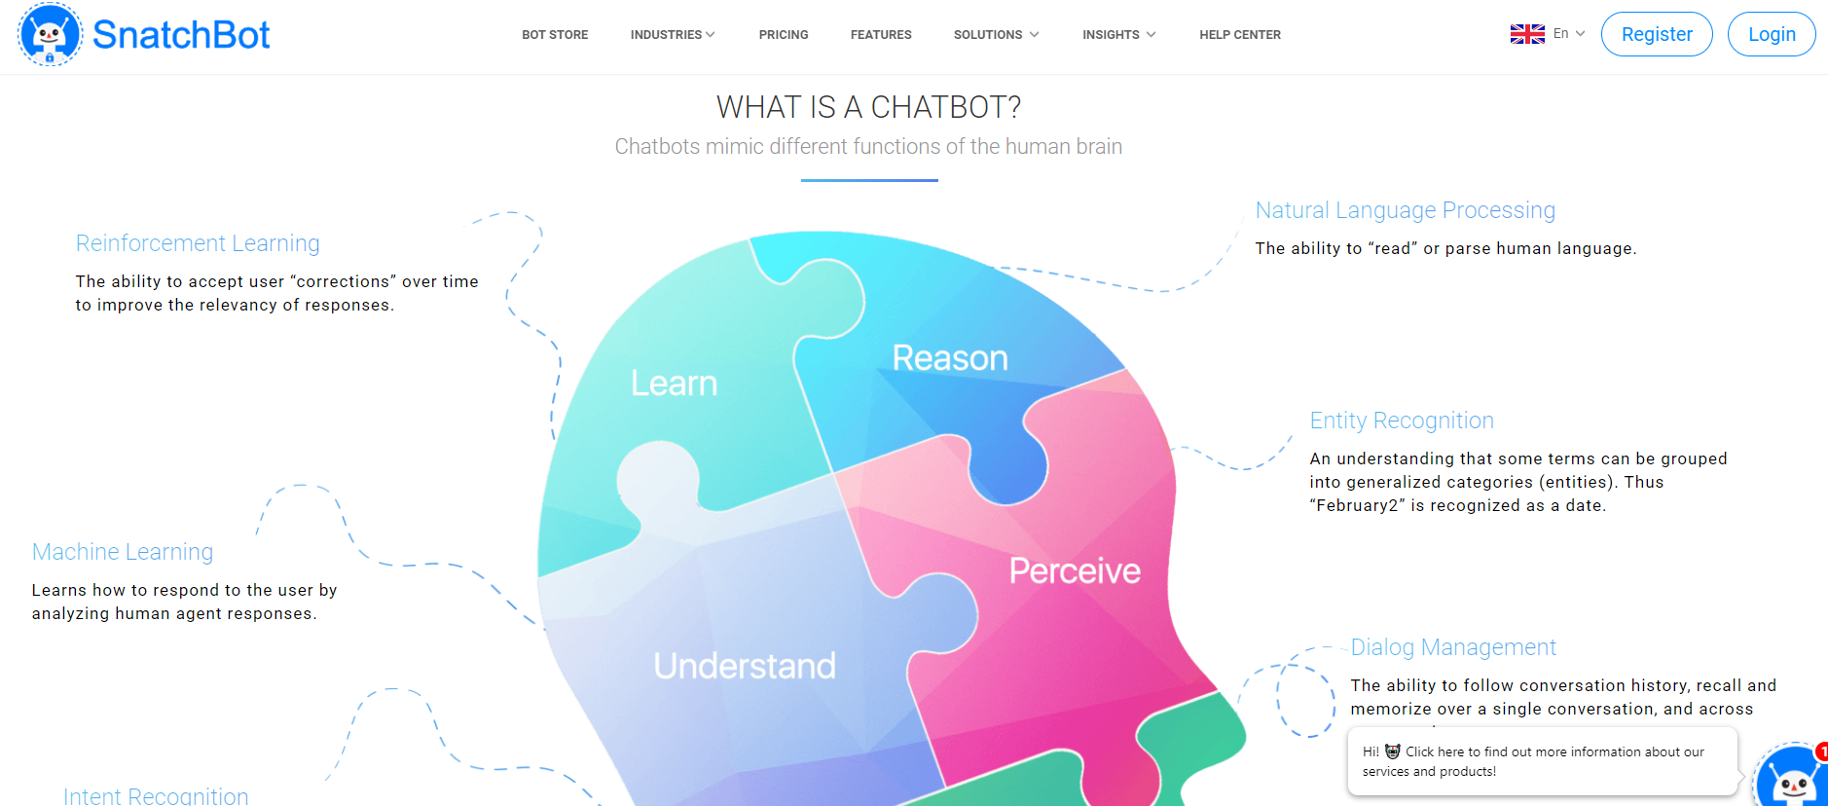
Solution

Slide 37
Help Center

Slide 38
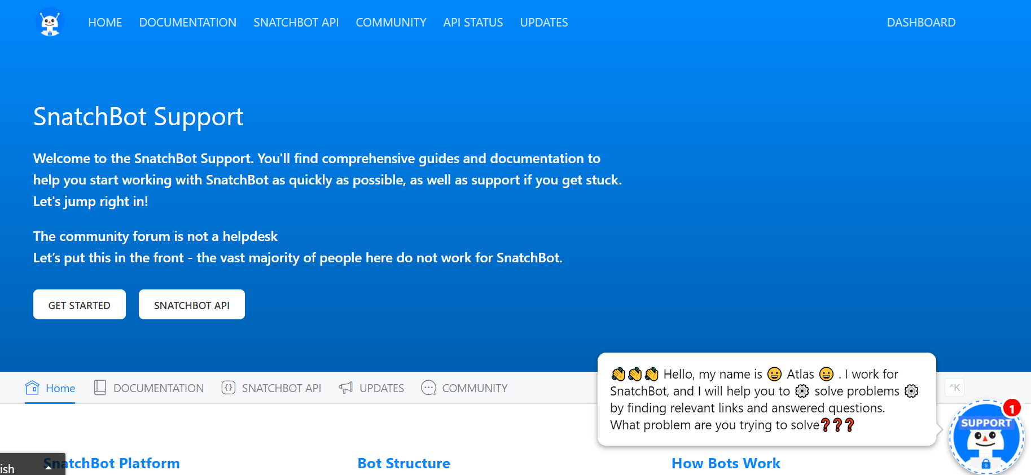
Help Center

Slide 39
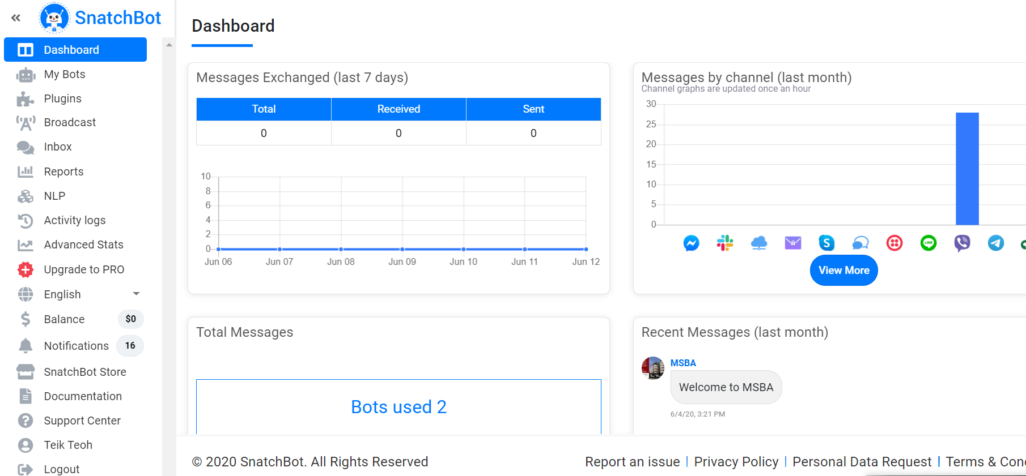
After Login - Creating Chatbot - Dashboard

Slide 40
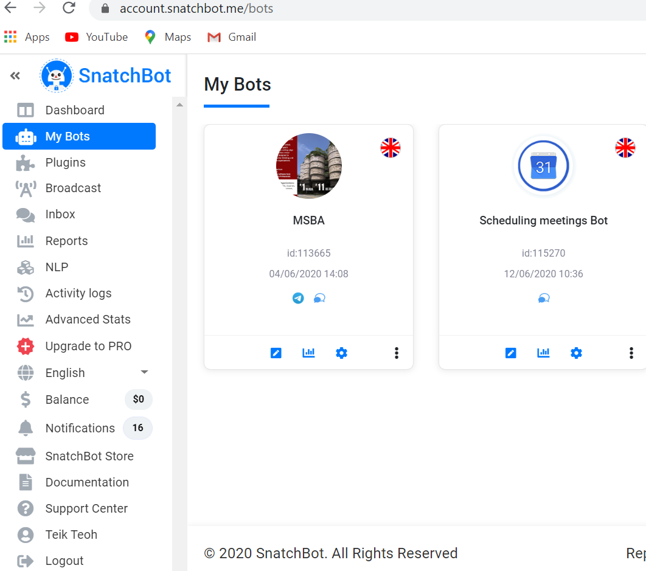

Slide 41
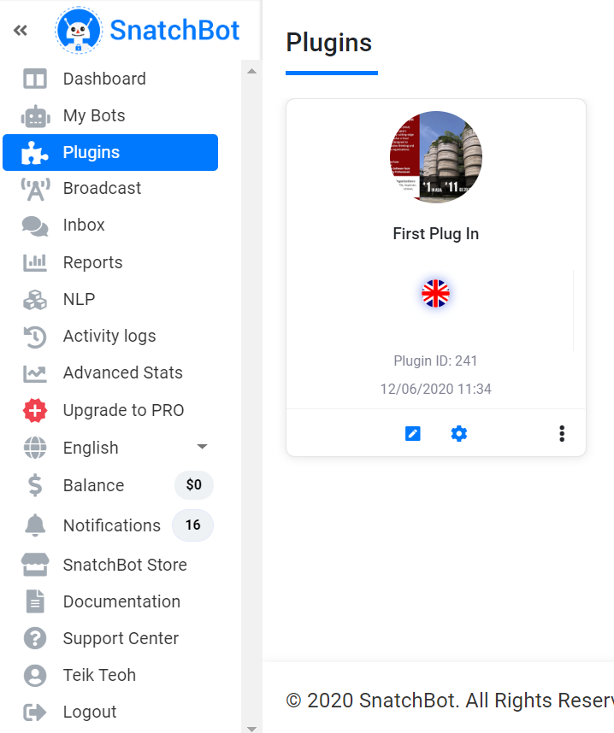

Slide 42
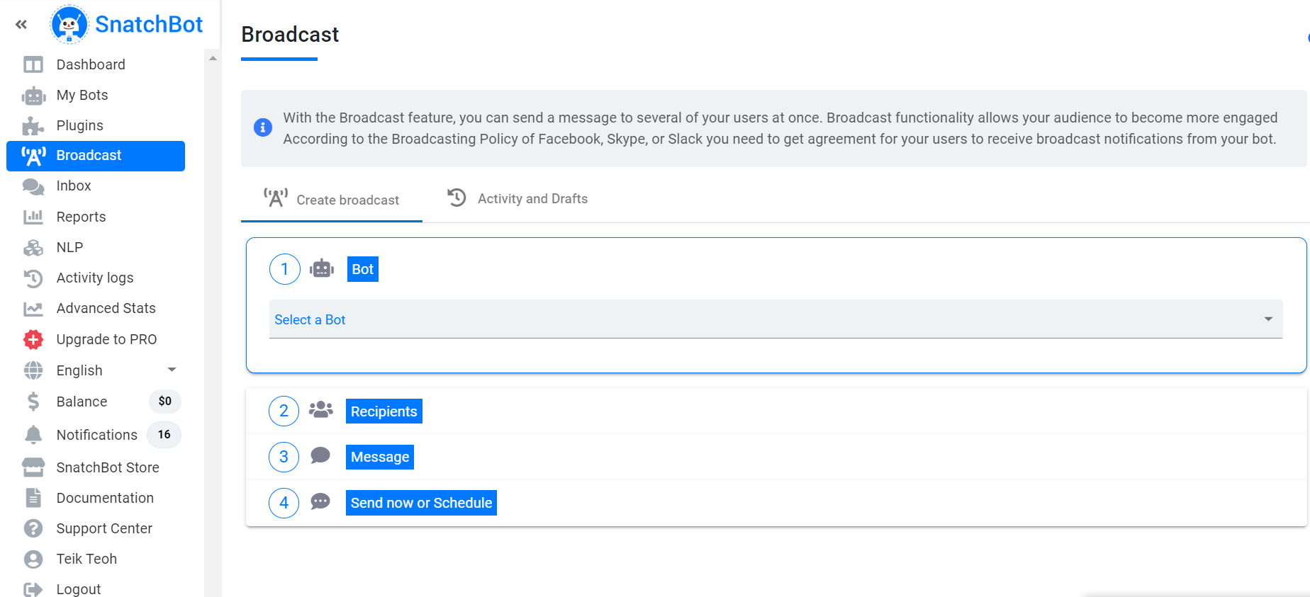

Slide 43
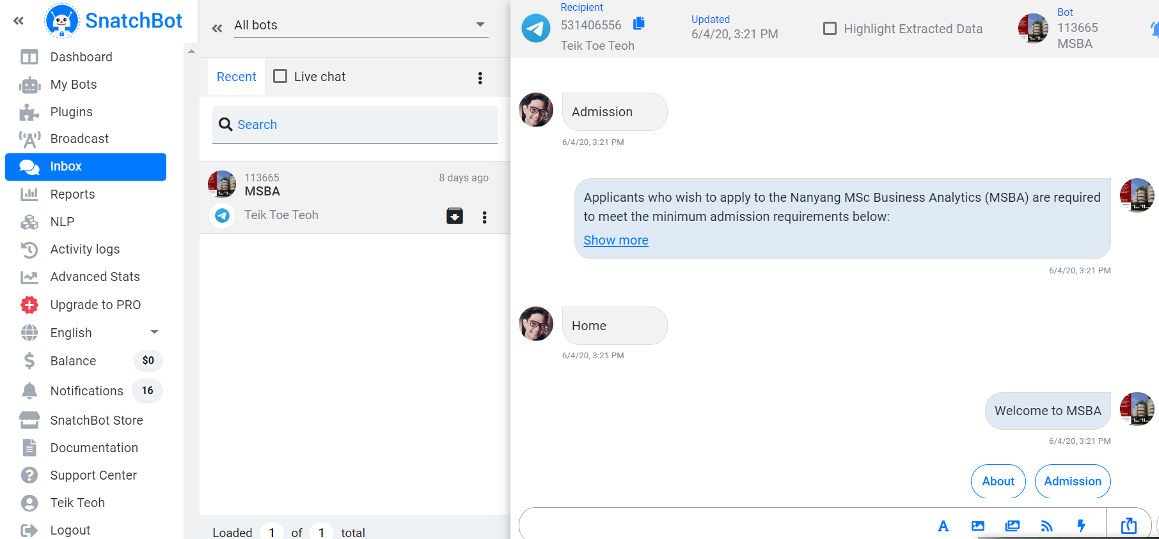

Slide 44
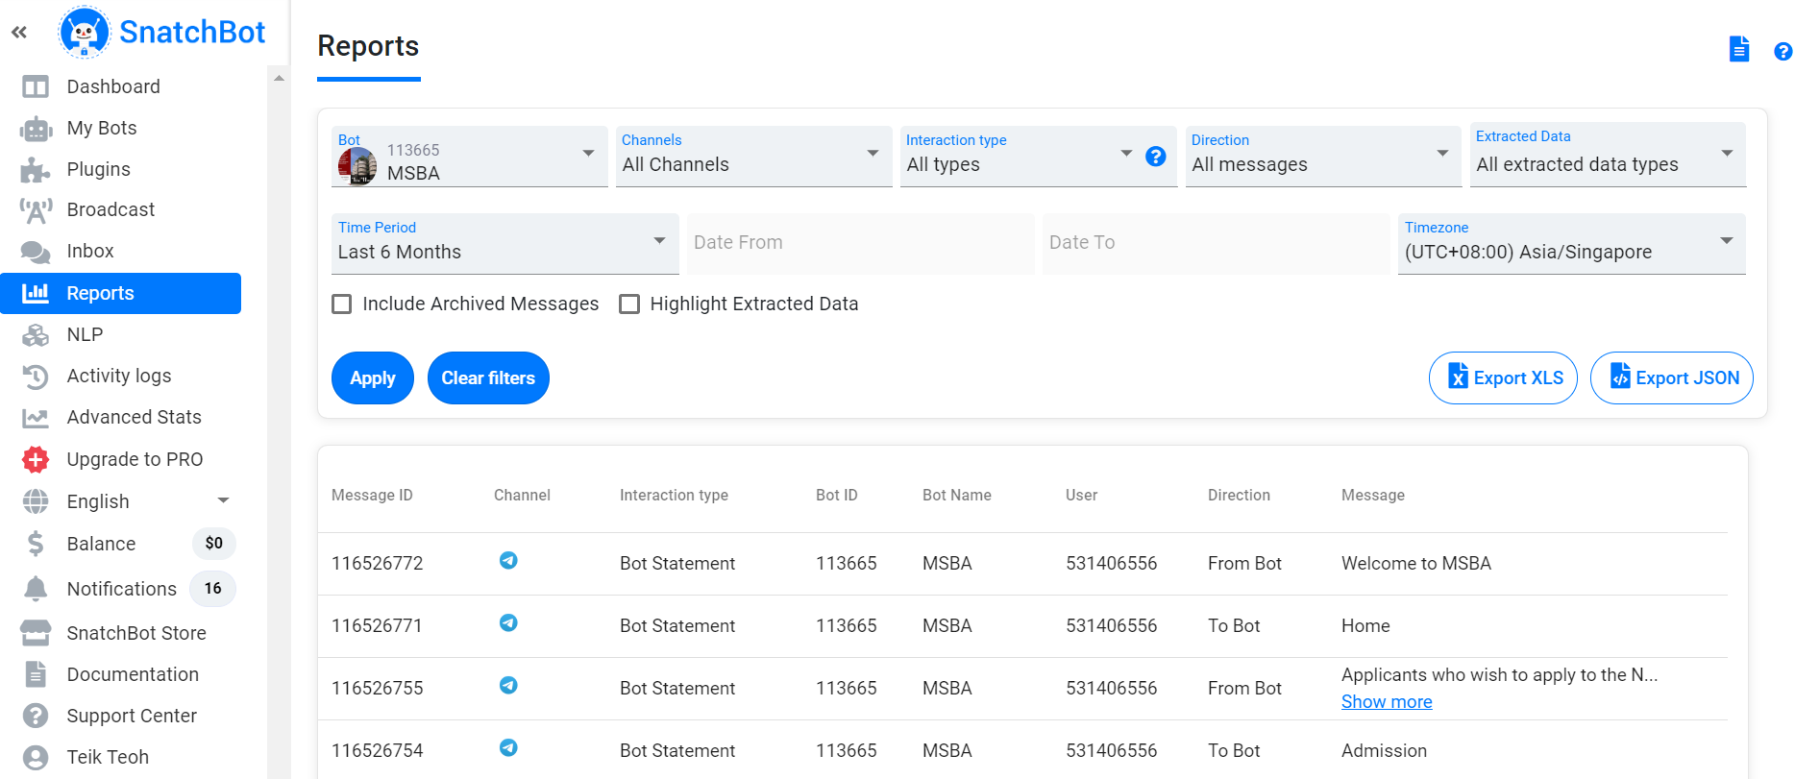

Slide 45
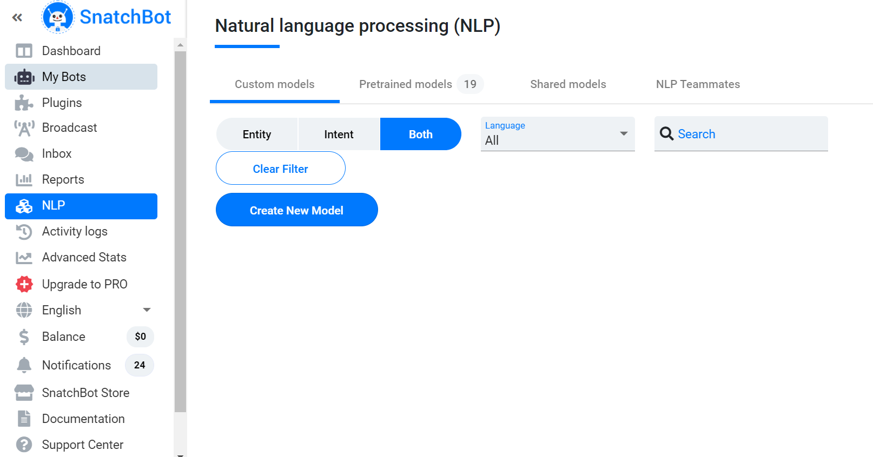
NLP

Slide 46
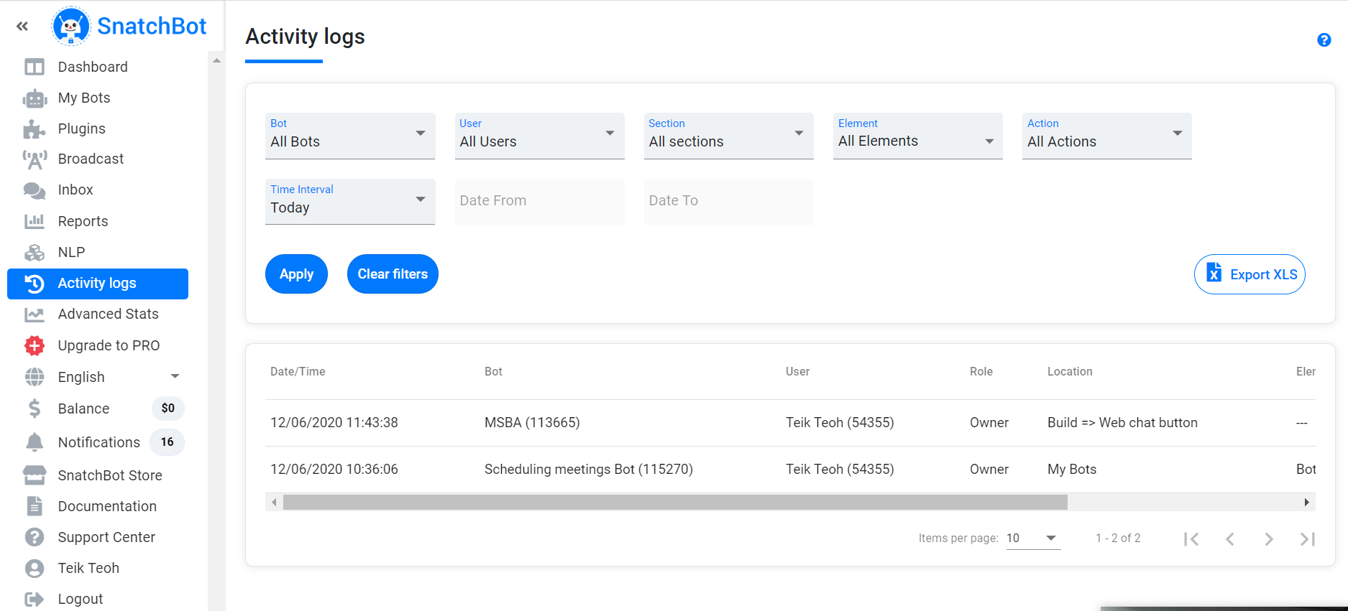

Slide 47
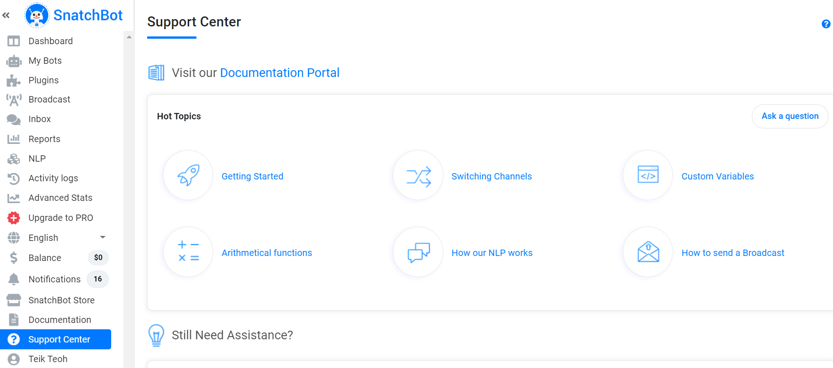

Slide 48
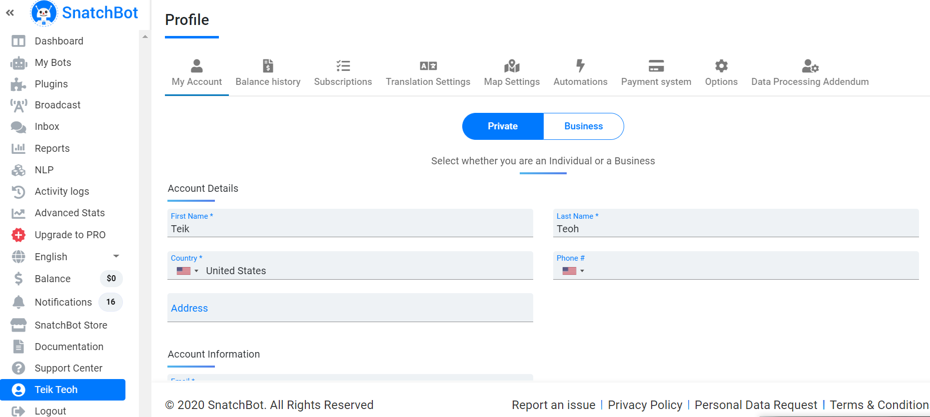

Slide 49
Creating Chatbot

Slide 50
Risk Management Chatbot
Create Chatbot for Risk Management
Depending on the age, suggest different profile

Slide 51
Create a chatbot (Add Interaction, Add Connection, remember?)
Picture (Welcome)
Save chatbot
Input (Main)
Synonyms
Weblink
Email
Set Variable
Conditional Statement (if)
NLP
Email Address Interaction

Slide 52
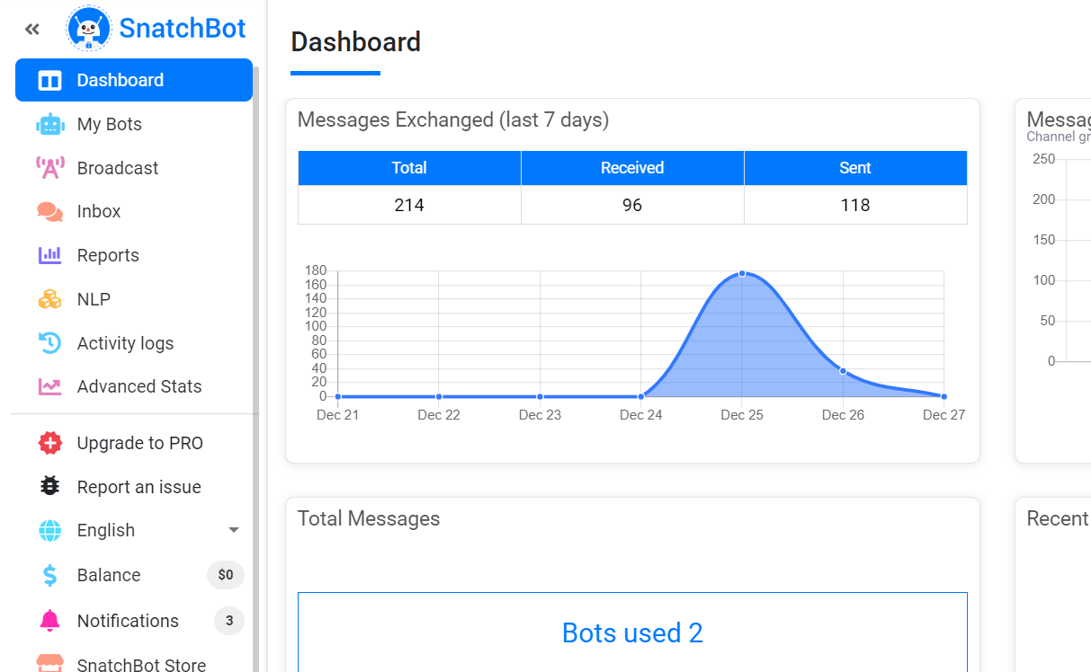
Creating chatbot
Click on My Bots in the side menu

Slide 53
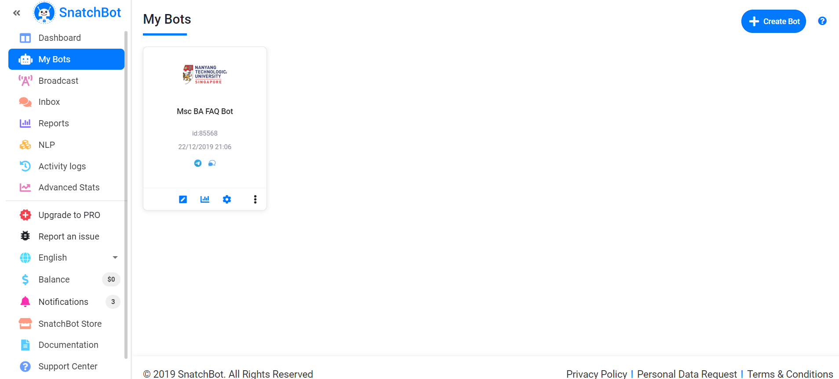
Creating a simple chatbot
Click Create bot

Slide 54
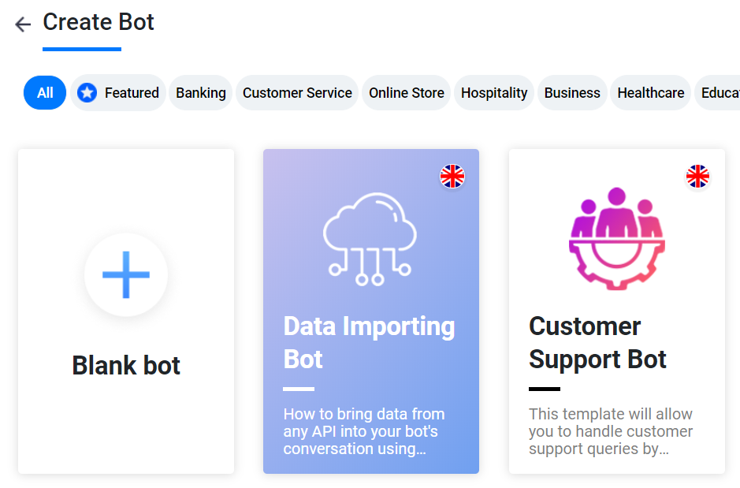
Creating a simple chatbot
Click on Blank Bot

Slide 55
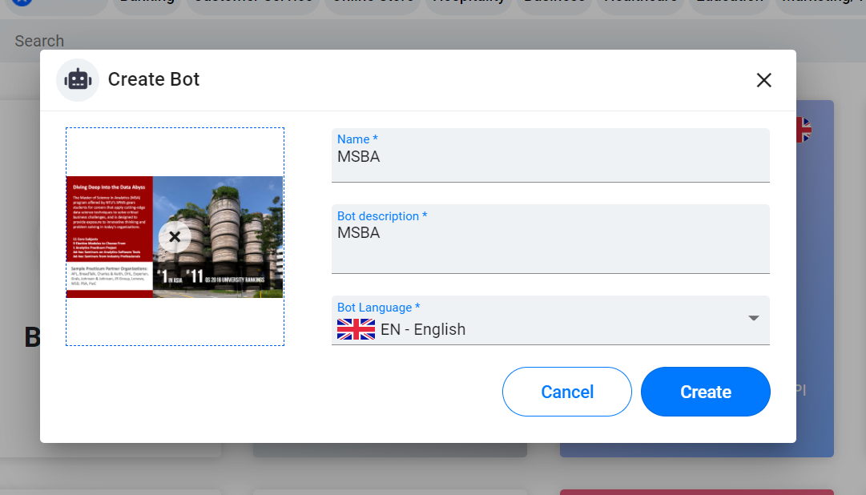
Create Bot

Slide 56
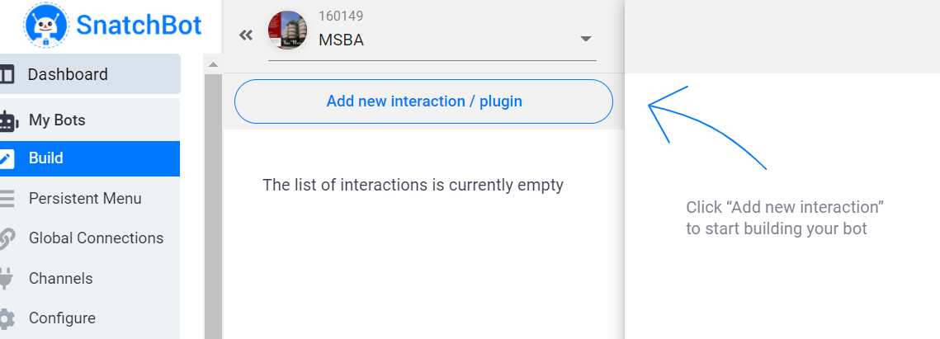
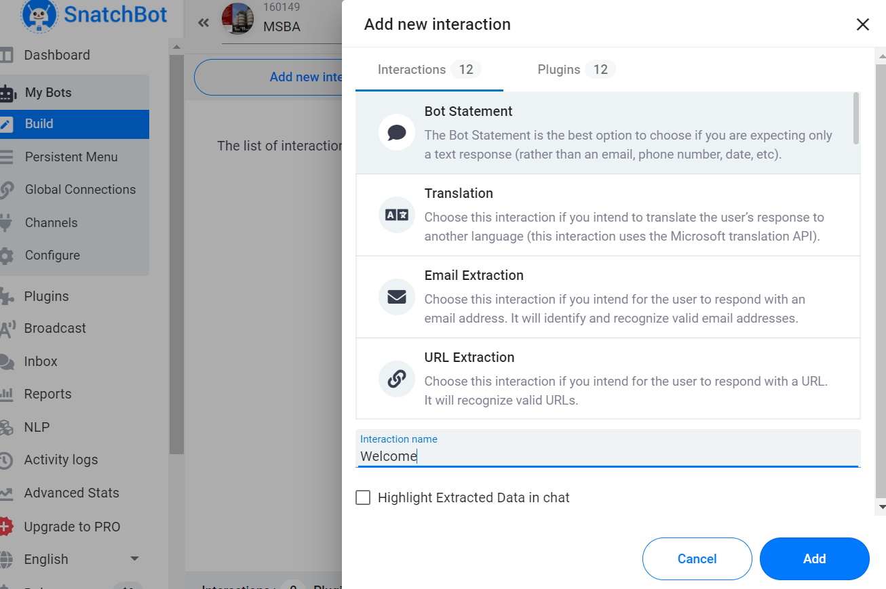
Add new interaction - Welcome

Slide 57

Bot Message – Welcome to MSBA, please enter your name

Slide 58

Add a photo in Welcome

Slide 59

Add another interaction - Main

Slide 60

In Welcome Connection, Select Fall Back to Main

Slide 61


Use prior response and then replace ID with interaction from welcome
Hi, [responseTo interaction=2450523 fallback=TEXT]. MSBA is a Programme to take you into the World of Data Analytics.

Slide 62

Connect Welcome to Main Using Fall Back Connection

Slide 63



Test Run & Bot Scheme

Slide 64
Add a photo in Main

Slide 65



Add 2 more connection, overview and why MSBA and the bot message

Slide 66



Connect Main to Overview using Quick Reply with Synonym – Repeat for Why

Slide 67


To close the loop, add connection in overview and why back to main

Slide 68

Variable and If Statement Crete 2 new interaction, GMAT Score and GMAT Eligibility and link main to GMAT

Slide 69


GMAT Score, Fall Back Connection to GMAT Eligibility

Slide 70



SET Variable: value change to prior response (remember to change the ID to GMAT Score) show variable using Get Value in Custom Variable (Change to GMAT)
Bot Message:
You have entered your score as [customVar GMAT=[responseTo interaction=2450604 fallback=TEXT]][showVar=GMAT]

Slide 71

After creating GMAT variable, use the if statement
Use Logic Operation
[IF([showVar=GMAT]=700){Congratulation, you are eligible.}]
[IF([showVar=GMAT]>700){Congratulation, you are eligible}]
[IF([showVar=GMAT]<700){Sorry, please take another GMAT test, we need a score of 700 and above.}]
Bot Message:
You have entered your score as [customVar GMAT=[responseTo interaction=2450604 fallback=TEXT]][showVar=GMAT]
[IF([showVar=GMAT]=700){Congratulation, you are eligible.}]
[IF([showVar=GMAT]>700){Congratulation, you are eligible}]
[IF([showVar=GMAT]<700){Sorry, please take another GMAT test, we need a score of 700 and above.}]

Slide 72



Connect GMAT Eligibility to Main and Run

Slide 73

NLP (Activate your NLP)

Slide 74


Try Detect Person

Slide 75

Add Recommendation Interaction and connect Main to Recommendation

Slide 76


In Recommendation Interaction, bot message is “Please enter your friend’s name”, in connection “Add NLP

Slide 77

Add NLP in Recommendation Interaction

Slide 78

Add Another Interaction call “Friend’s Email” using Email Extraction

Slide 79

For Email Extraction, you need to enter Error Response if the entry is not valid

Slide 80

Remember to link Friend’s Email Interaction back to Main using Fallback

Slide 81

Email – Go to Mail and select Configure

Slide 82


Weblink – Select Embedded Media, change the url.
Bot Message: Hi, [responseTo interaction=2450523 fallback=TEXT]. MSBA is a Programme to take you into the World of Data Analytics. The weblink is [url=https://nbs.ntu.edu.sg/Programmes/Graduate/MScBusinessAnalytics/Pages/home.aspx]LABEL_URL[/url]

Slide 83
Summary

Slide 84

Set Variable
[customVar GMAT = [responseTo interaction=2735510 fallback=TEXT]]
You have entered your GMAT score as [showVar=GMAT]

Slide 85
If statement
[customVar GMAT = [responseTo interaction=2735510 fallback=TEXT]]
You have entered your GMAT score as [showVar=GMAT].
[IF( [showVar=GMAT]=700){Congrats, you are eligible for MSBA.}]
[IF( [showVar=GMAT]>700){Congrats, you are eligible for MSBA.}]
[IF( [showVar=GMAT]<700){Sorry, you need take your GMAT again.}]

Slide 86

Email

Slide 87

NLP

Slide 88

Save as a file

Slide 89

Deploying the chatbot on telegram
Click on channels
Click on telegram

Slide 90

Deploying the chatbot on telegram
Download telegram
Create an account
Go to telegram web at https://web.telegram.org/
Type BotFather in the search bar

Slide 91

Deploying the chatbot on telegram
Click on the start button or press /start

Slide 92

Deploying the chatbot on telegram
Type /newbot
Type the name of your telegram bot in our example it is “NTU MSBA FAQ”
Type the unique telegram username for your bot in our example it is “MSBA_bot”
Copy the token

Slide 93

Deploying the chatbot on telegram
Go back to snatchbot and scroll down to click on step 3.
Paste the Telegram API token

Slide 94

Deploying the chatbot on telegram
Click Deploy

Slide 95


Finding chatbot on telegram
In the telegram search bar type in the name of your telegram bot and find it.
Click on your telegram bot
Press start to begin chatting

Slide 96

If no error, fallback.
Default
Fallback

Slide 97
Try Google Meena
https://www.youtube.com/watch?v=cA0vHYzGR8s
https://www.youtube.com/watch?v=3Wppf_CNvD0

Slide 98

More syntax refer to “Support Center”

Slide 99
Exercise
Create a new bot
Create 2 links from the website
Recommendation using NLP
Brochures using Get Email Interaction
GMAT score using condition statement (>700 eligible)

Slide 100
Exercise
Modify one of the template in Snatchbot
Present your chatbot next week

Slide 101
Exercise
Create a financial portfolio chatbot by asking the person’s name, age and email address.
Base on the age:
Above 40 -> Low Risk Portfolio (80% Bond, 20% Equity)
40 or Below -> High Risk Portfolio (80% Equity, 20% Bond)
Email (Only header) the person the information.
Please submit both screenshot (word) and snatchbot file.
https://www.ubs.com/global/en/assetmanagement.html
https://money.cnn.com/retirement/guide/investing_basics.moneymag/index7.htm

Slide 102
Recap
What are some the successful examples of chatbot?
What can Snatchbot do?
Why chatbot is so important today?
Why do we want to use Snatchbot library?
What are the current libraries available in Snatchbot?

Slide 103
Chatbot in Python
Demo: https://coronaminimastersdemo.herokuapp.com/
Source Code: https://www.dropbox.com/sh/4a7qrjkj6eaeezo/AABI-GiI7dVt-g5n7BfXemVba?dl=0

Slide 104
Resources
https://www.youtube.com/watch?v=kVWZJg47QGU
https://www.youtube.com/watch?v=zs2KXGXGzJE
https://www.youtube.com/watch?v=Mso6DdMxfQQ
https://www.youtube.com/watch?v=xosG6LuUuk4

Slide 105
Resources
https://www.youtube.com/watch?v=yTPrs5lYgnA
https://www.youtube.com/watch?v=1vQLArE8xVw
https://www.youtube.com/watch?v=Fz7_0IxfJBw&t=16s
https://www.youtube.com/watch?v=1swBBSCrMkA

Slide 106
Top Chatbot Tools
https://www.youtube.com/watch?v=_JOUrYsjkTM&feature=youtu.be

Slide 107
Alternatively - sendpulse
https://login.sendpulse.com/messengers/connect/

Slide 108
Join 2 if statement
[IF([responseTo interaction=1180608 fallback=no]=I'm 21){[IF([responseTo interaction=1180652 fallback=no]=35 Lessons Package){ € 741,10 for a year subscription of 35 lessons of 30 minutes per lesson including 21% btw. You can pay it in one go or in 3 instalments. The last option has an administration fee of €7,50.}]}]
[IF([responseTo interaction=1180608 fallback=no]=I'm older than 21){[IF([responseTo interaction=1180652 fallback=no]=35 Lessons Package){ € 741,10 for a year subscription of 35 lessons of 30 minutes per lesson including 21% btw. You can pay it in one go or in 3 instalments. The last option has an administration fee of €7,50.}]}]
[IF([responseTo interaction=1180608 fallback=no]=I'm younger than 21){[IF([responseTo interaction=1180652 fallback=no]=35 Lessons Package){ € 612,50 for a year subscription of 35 lessons of 30 minutes per lesson. You can pay it in one go or in 3 instalments. The last option has an administration fee of €7,50.}]}]

Slide 109
Thank You

